Slide 1
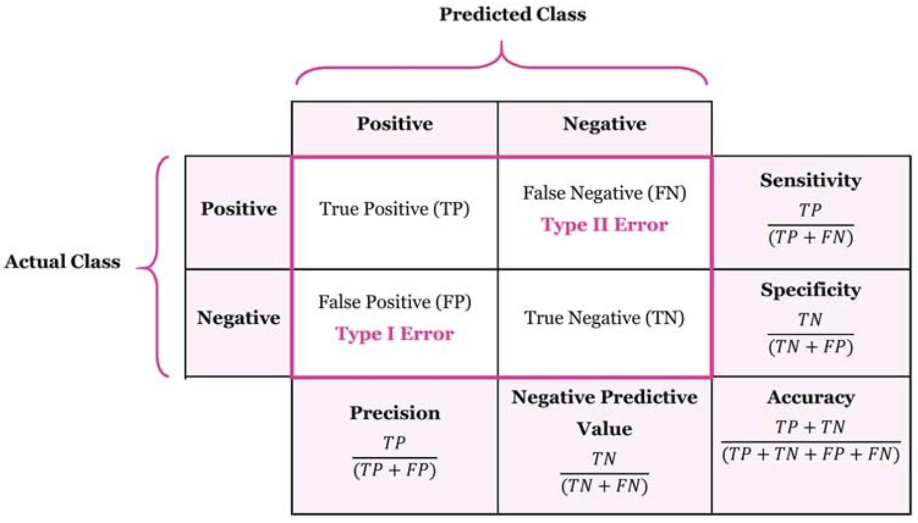
Precision and Recall
https://stevengong.co/notes/Precision-Recall

Slide 2
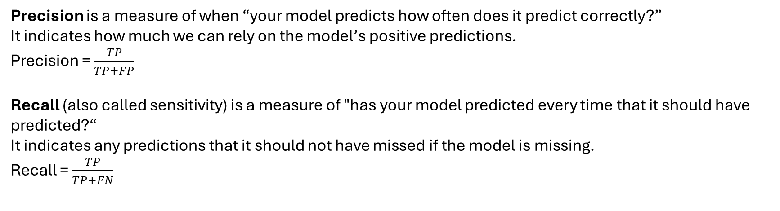
Precision and Recall
Precision is a measure of when “your model predicts how often does it predict correctly?”
It indicates how much we can rely on the model’s positive predictions.
Precision = $\frac{TP}{TP+FP}$​
Recall (also called sensitivity) is a measure of "has your model predicted every time that it should have predicted?“
It indicates any predictions that it should not have missed if the model is missing.
Recall = $\frac{TP}{TP+FN}$​

